Slide 1
Central Processing Unit
Central Processing Unit Stack Organization

Slide 2
Central Processing Unit Stack Organization
Introduction
General Register Organization Execution of Instruction
Introduction
One of the Major functional part in a digital computer is Central Processing Unit.
The main digital hardware functional unit of CPU are control unit, ALU and registers.
The register set stores intermediate data used during the execution of the instruction.
The ALU performs the required micro-operation for executing the instruction.
The control unit supervises the transfer of information among the registers and instruct ALU to perform which operation.

Slide 3
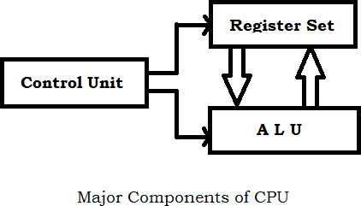
Central Processing Unit Stack Organization
Introduction
General Register Organization Execution of Instruction
Central Processing Unit

Slide 4
Central Processing Unit Stack Organization
Introduction
General Register Organization Execution of Instruction
General Register Organization
Memory locations are needed for storing pointers, counters, return addresses, temporary results, and partial products during multiplication.
As memory access is time consuming process better to have those values in processor registers.
To have a large nos of registers, it have to connected with a common bus system.
It will be part of various micro-operation like arithmetic, logic and shift operation in the processor.

Slide 5
Central Processing Unit Stack Organization
Introduction
General Register Organization Execution of Instruction
Execution of Instruction
The Control unit that operates the CPU bus system directs the information flow through the registers and ALU by selecting the various components.
For example:
R1 <- R2 + R3
MUX A selector (SELA): to place the content of R2 into bus A.
MUX B selector (SELB): to place the content of R3 into bus B.
ALU operation selector (OPR): to provider the arithmetic
addition A + B.
Decoder destination selector (SELD): to transfer the content of the output bus into R1.

Slide 6
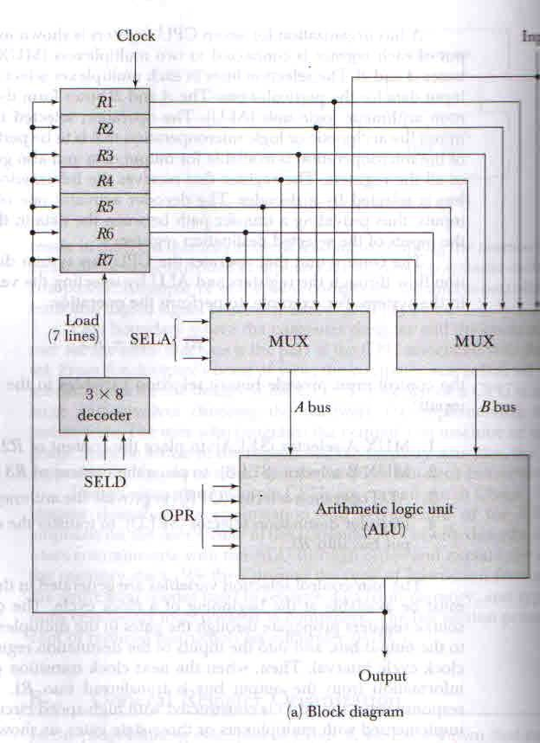
Central Processing Unit Stack Organization
Introduction
General Register Organization Execution of Instruction
General Register Organization

Slide 7
Central Processing Unit Stack Organization
Introduction
General Register Organization Execution of Instruction
Execution of Instruction
The four control selection variables are generated in the control unit and must be available at the beginning of a clock cycle.
The buses are implemented with multiplexers or three-state gates.

Slide 8
Central Processing Unit Stack Organization
Introduction Register Stack
Introduction
A useful feature that is included in the CPU of most computer is a Stack.
A Stack is a storage device that stores information in such a manner that the item stored last is first item retrieved.
The stack in digital computers is essentially a memory unit with an address register - called stack pointer(SP).
The two operation of a stack are the insertion and deletion of items i.e. push and pop.

Slide 9
Central Processing Unit Stack Organization
Introduction Register Stack
Register Stack
A stack can be placed in a portion of a large memory or registers.
A stack pointer register(SP) contains a binary number whose value is equal to the address of the word that is currently on the top of the stack.

Slide 10
Central Processing Unit Stack Organization
Introduction Register Stack
Register Stack
Suppose, three items are placed in the stack : A, B, and C.
Item C is on the top of the stack so that the content of SP is indicating to the address of C.
To remove the top item, the stack is popped by reading the memory word and decrement the content of SP. Now, B is on the top.
To insert a new item, the stack is pushed by incrementing SP and writing a word in the next-higher location of the stack.

Slide 11
Central Processing Unit Stack Organization
Introduction Register Stack
THANK YOU

